Slide 1

TOPIC-Operating System
COURSE: CCC Concept
CHAPTER: 01 (Operating System)
DAY: 10
NIELIT
Presentation By :Anjali Dhingan

Slide 2
Operating Systems for Mobile Phone and Tablets
A mobile operating system, also called a mobile OS, is an operating system that is specifically designed to run on mobile devices such as mobile phones, smart phones, PDAs, tablet computers and other handheld devices.
Types of Mobile Operating Systems
Android OS (Google Inc.) The Android mobile operating system is Google's open and free software stack that includes an operating system, middleware and also key applications for use on mobile devices, including smart phones. Updates for the open source Android mobile operating system have been developed under "dessert-inspired" version names (Cupcake, Donut, Éclair, Gingerbread, Honeycomb, Ice Cream Sandwich) with each new version arriving in alphabetical order with new enhancements and improvements.
iPhone OS / iOS (Apple) Apple's iPhone OS was originally developed for use on its iPhone devices. Now, the mobile operating system is referred to as iOS and is supported on a number of Apple devices including the iPhone, iPad, iPad 2 and iPod Touch. The iOS mobile operating system is available only on Apple's own manufactured devices as the company does not license the OS for third-party hardware. Apple iOS is derived from Apple's Mac OS X operating system.

Slide 3
Operating Systems for Mobile Phone and Tablets
BlackBerry OS The BlackBerry OS is a proprietary mobile operating system developed by Research In Motion for use on the company’s popular BlackBerry handheld devices. The BlackBerry platform is popular with corporate users as it offers synchronization with Microsoft Exchange, Lotus Domino, Novell GroupWise email and other business software, when used with the BlackBerry Enterprise Server.
Symbian: Nokia’s favorite operating system Symbian took the fourth spot. It is now obsolete and does not interests anyone. But for small budget phones it is 1 definitely a good deal.

Slide 4
Operating Systems for Mobile Phone and Tablets
Windows Mobile (Windows Phone) Windows Mobile is Microsoft's mobile operating system used in smart phones and mobile devices – with or without touch screens. The Mobile OS is based on the Windows CE 5.2 kernel. In 2010 Microsoft announced a new smart phone platform called Windows Phone
7. Windows phone 10 was released in November 2015 and is included in Microsoft’s smart phones and tablets.
Bada (Samsung Electronics) Bada is a proprietary Samsung mobile OS that was first launched in 2010. The Samsung Wave was the first smartphone to use this mobile OS. Bada provides mobile features such as multipoint-touch, 3D graphics and of course, application downloads and installation.

Slide 5
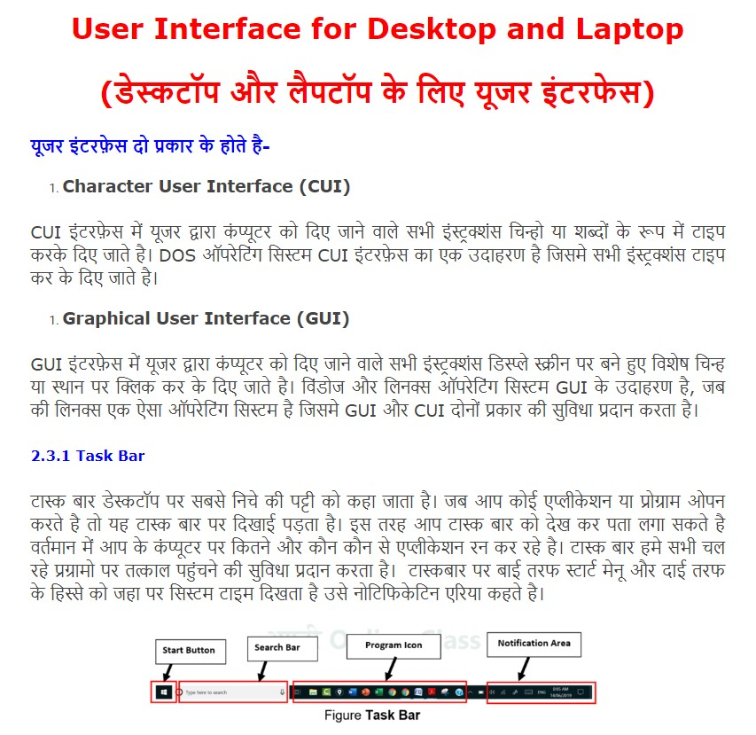
User Interface for Desktop and Laptop

Slide 6
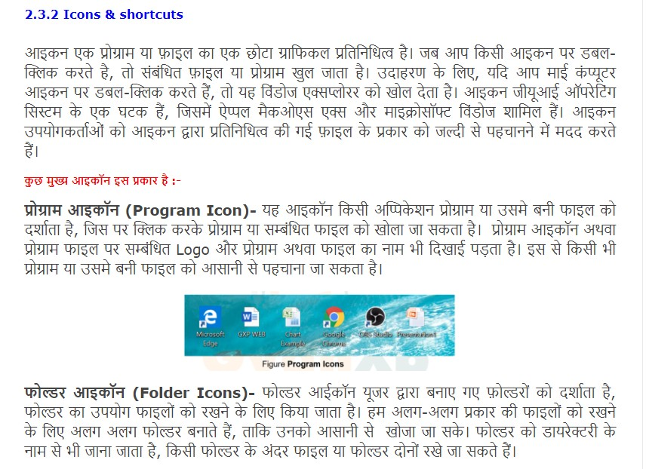

Slide 7
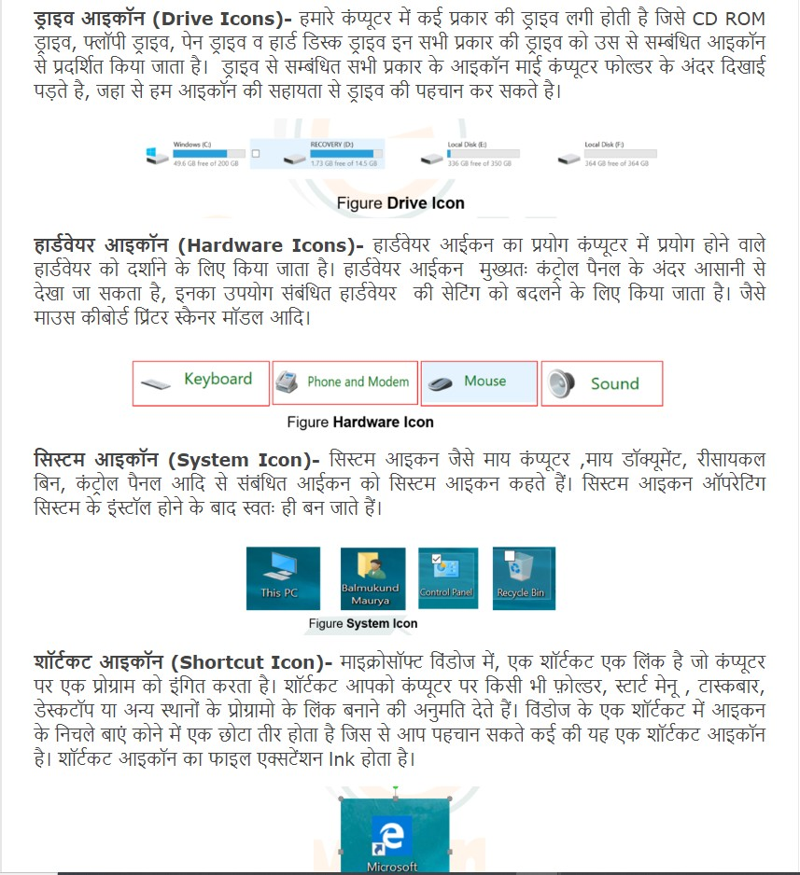

Slide 8
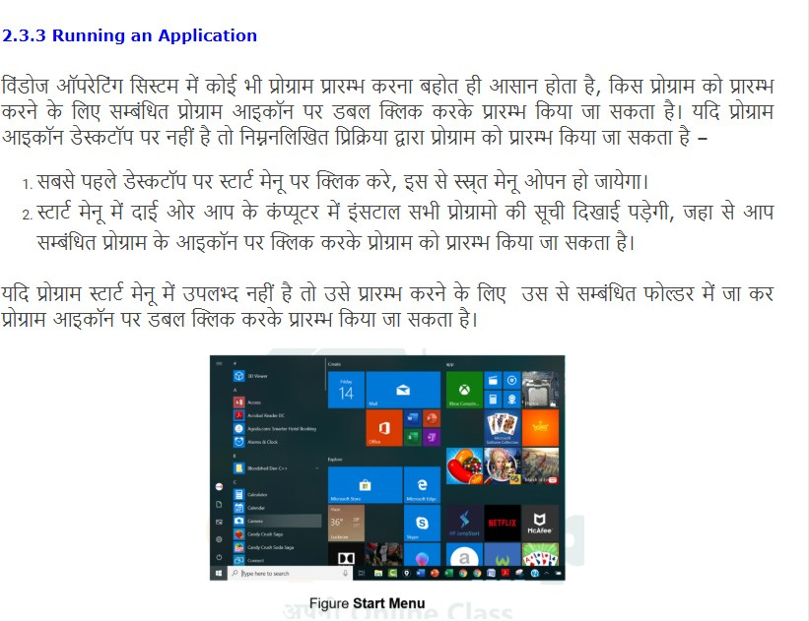

Slide 9
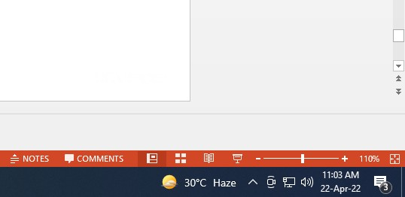

Operating System simple setting
Change Date/Time
Right Click

Slide 10
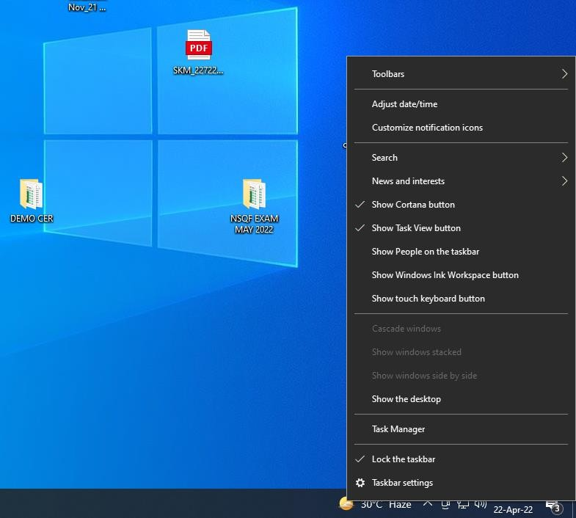

Operating System simple setting

Slide 11
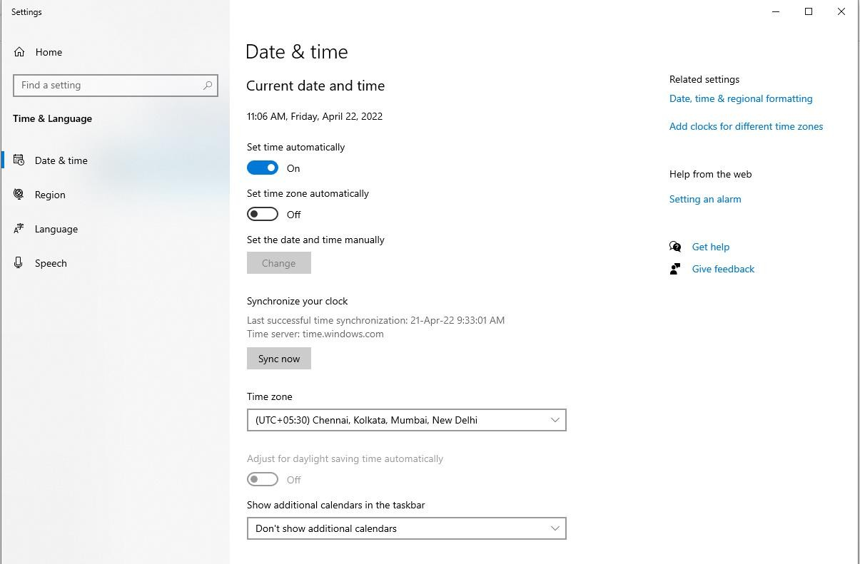

Operating System simple setting

Slide 12
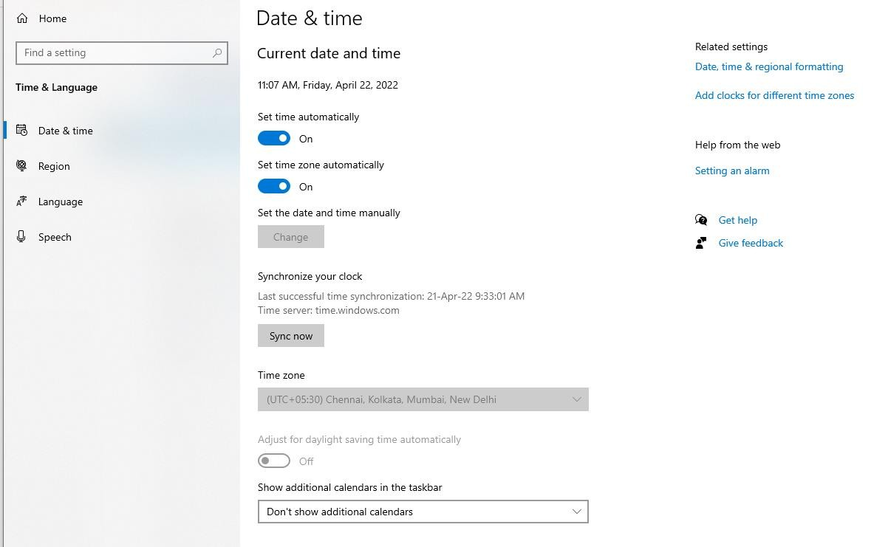

Operating System simple setting

Slide 13
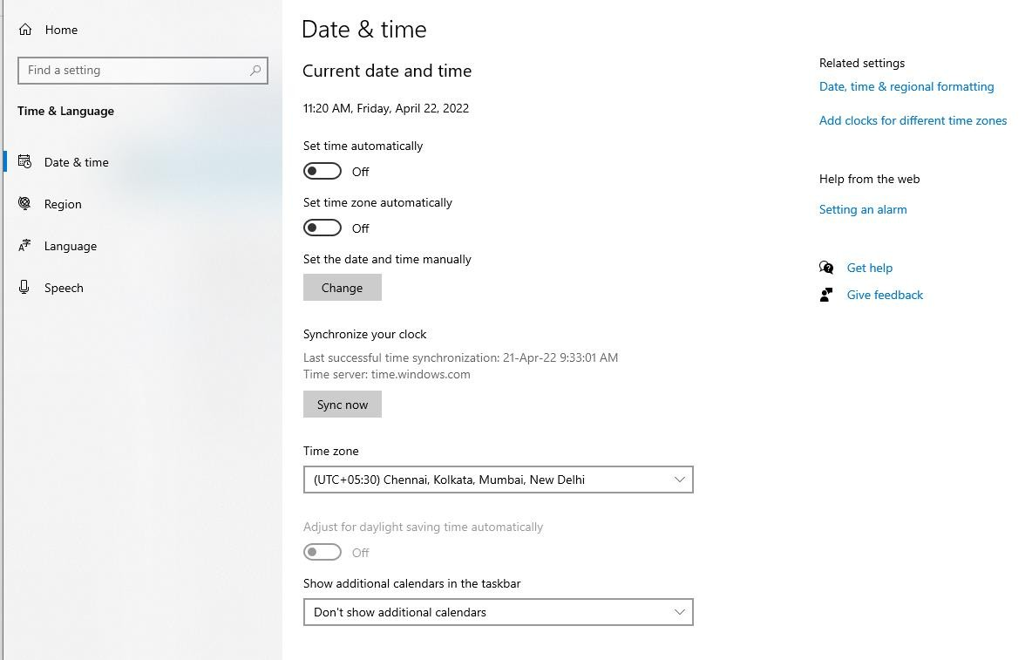

Operating System simple setting

Slide 14
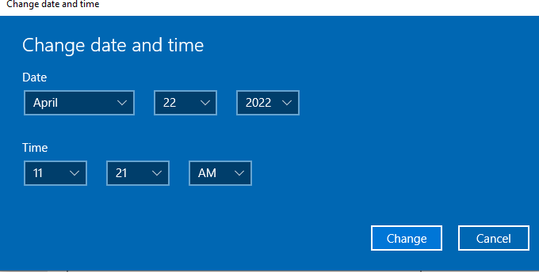

Operating System simple setting

Slide 15
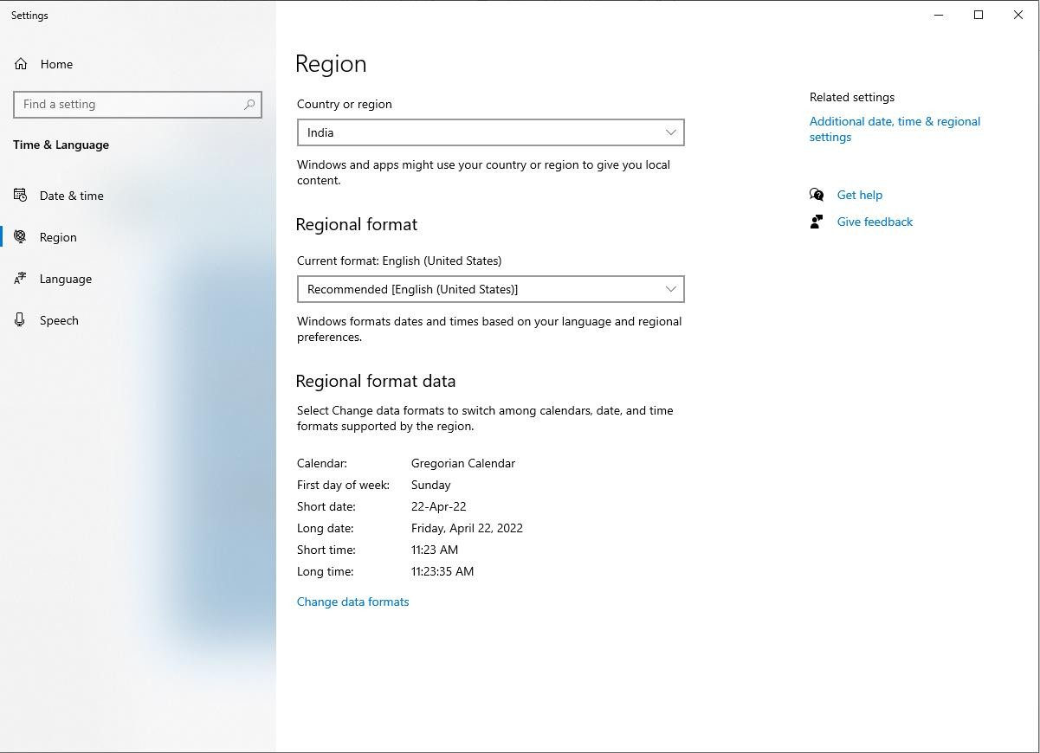

Operating System simple setting

Slide 16
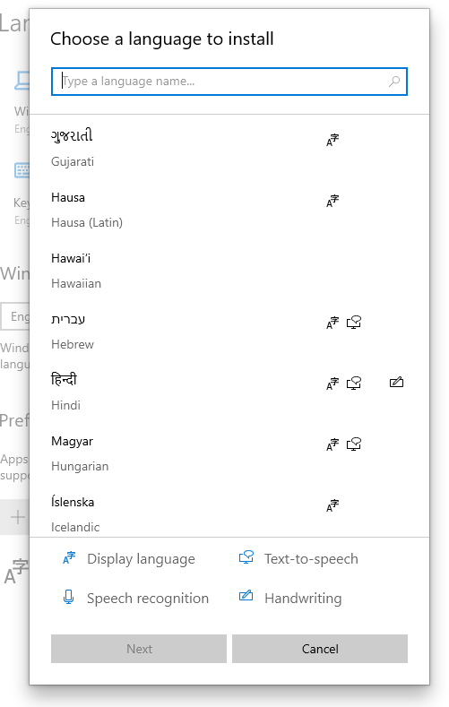
Operating System simple setting

Slide 17
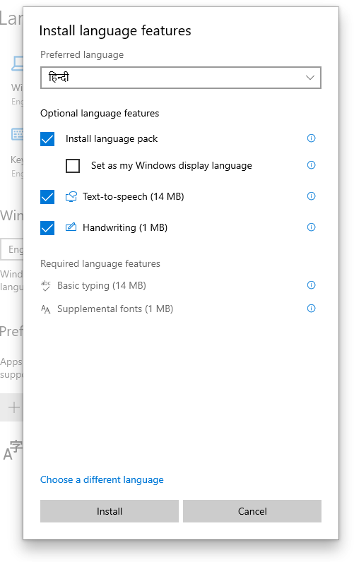
Operating System simple setting

Slide 18
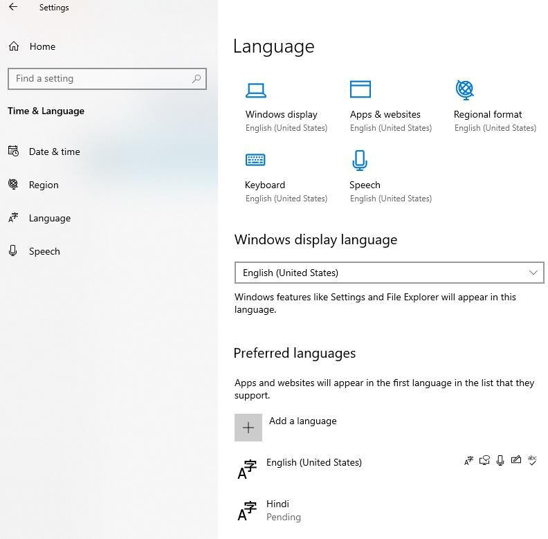
Operating System simple setting

Slide 19
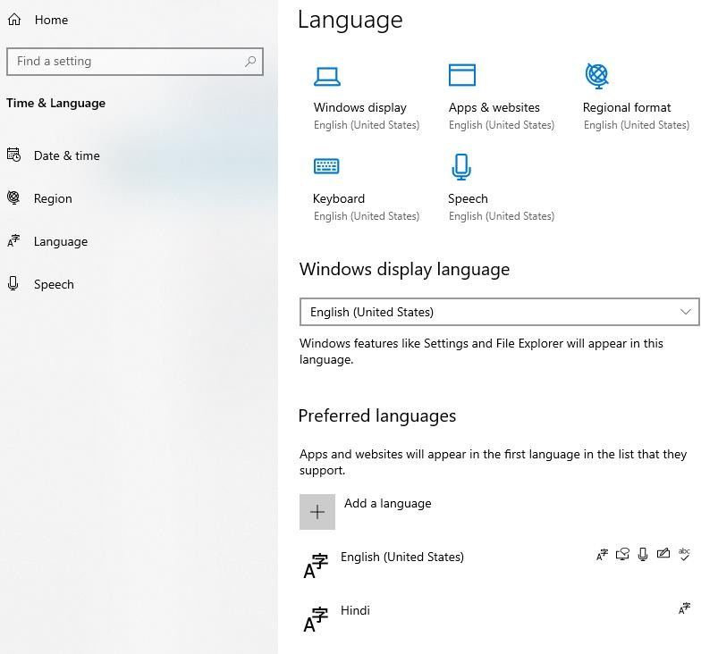
Operating System simple setting

Slide 20
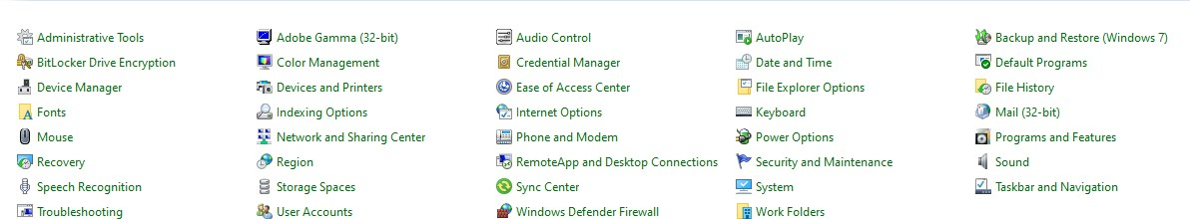
Using mouse and changing its properties

Slide 21
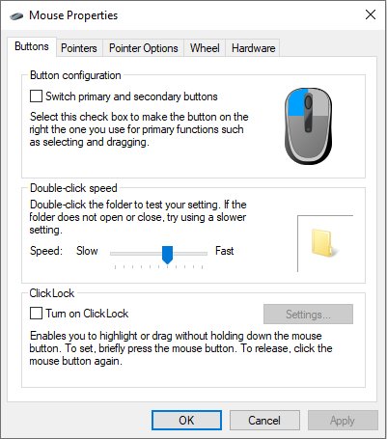
Button
Button configuration
Double-click-speed Click Lock

Slide 22
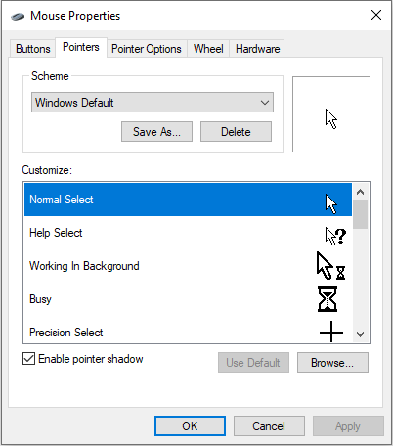
Pointers
Customize

Slide 23
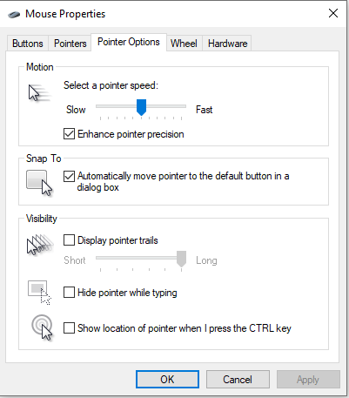

Slide 24
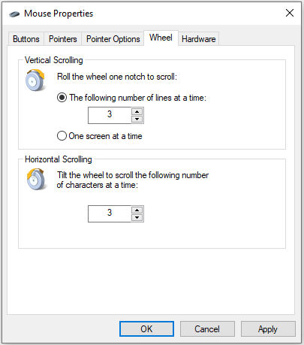

Slide 25
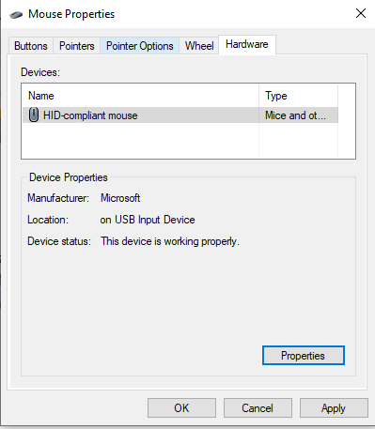

Slide 26
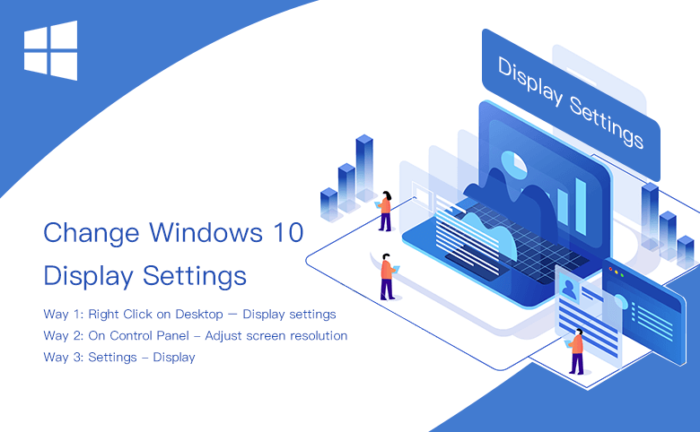
Changing display properties

Slide 27
to add or remove Program and its features
Press the Windows key , type Programs and Features or Add and remove programs, then press Enter .
A window similar to that shown above should appear.
From the Programs and Features section of Windows, you can uninstall a program, adjust Windows features, and view installed updates.

Slide 28
Thank You
NIELIT

